Slide 1


Slide 2

21
MONITORING JOBS AND INFLATION
Notes:
Notes and teaching tips: 4, 8, 9, 26, 30, 32, 43, 47, and 59.
To view a full-screen figure during a class, click the expand button.
To return to the previous slide, click the shrink button.
To advance to the next slide, click anywhere on the full screen figure.
Applying the principles of economics to interpret and understand the news is a major goal of the principles course. You can encourage your students in this activity by using the two features: Economics in the News and Economics in Action.
(1) Before each class, scan the news and select two or three headlines that are relevant to your session today. There is always something that works. Read the headline and ask for comments, interpretation, discussion. Pose questions arising from it that motivate today’s class. At the end of the class, return to the questions and answer them with the tools you’ve been explaining.
(2) Once or twice a semester, set an assignment, for credit, with the following instructions:
(a) Find a news article about an economic topic that you find interesting.
(b) Make a short bullet-list summary of the article.
(c) Write and illustrate with appropriate graphs an economic analysis of the key points in the article.
Use the Economics in the News features in your textbook as models.

Slide 3
After studying this chapter, you will be able to:
Explain why unemployment is a problem and define the unemployment rate and other labour market indicators
Explain why unemployment is present even at full employment, and how its rate fluctuates over a business cycle
Explain why inflation is a problem and how we measure it using the CPI

Slide 4
Employment and Unemployment
What kind of job market will you enter when you graduate?
The class of 2014 had a tough time:
In July 2014, 1.4 million Canadians wanted a job but couldn’t find one and another 600,000 had given up looking for a full-time job and taken a part-time job.
The Canadian economy creates lots of jobs: 16.8 million people had jobs during the recession of 2009.
But in recent years, the population has grown faster than the number of jobs, so unemployment is a serious problem.
Notes:
Classroom activity
Check out Economics in Action: What Keeps Ben Bernanke Awake at Night

Slide 5
Employment and Unemployment
Why Unemployment Is a Problem
  Unemployment results in
  Lost incomes and production
  Lost human capital
  The loss of income is devastating for those who bear it. Unemployment benefits create a safety net but don’t fully replace lost wages, and not everyone receives benefits.
  Prolonged unemployment permanently damages a person’s job prospects by destroying human capital.

Slide 6
Employment and Unemployment
Labour Force Survey
Every month, Statistics Canada conducts a Labour Force Survey in which it asks 54,000 households.
  The population is divided into two groups:
  1. The working-age population—the total number of people aged 15 years and over
  2. People too young to work (under 15 years of age)

Slide 7
Employment and Unemployment
  The working-age population is divided into two groups:
  1. People in the labour force
  2. People not in the labour force
  The labour force is the sum of employed and unemployed workers.

Slide 8
Employment and Unemployment
  To be counted as unemployed, a person must be in one of the following three categories:
  1. On temporary layoff with an expectation of recall
  2. Without work but has made specific efforts to find a job within the previous four weeks
  3. Has a new job to start within four weeks
Notes:
Positive versus normative. Unemployment is an emotionally charged subject and is a good one for reinforcing the important point that economics is positive in contrast to normative. The economist’s job is to try to explain why unemployment exists, what determines its rate, and assess the efficient amount of unemployment.
The benefits of unemployment. It comes as a shock to most students that unemployment has benefits as well as costs and that there is an efficient amount of unemployment that is greater than zero. (Note that this statement is positive!) You might like to spend a bit of class time on this topic. If you do, here are some ideas about what to do:
A good way to introduce the idea that unemployment brings benefits is to think about the unemployment of things rather than people. Look around the campus and notice all the unemployed automobiles in the parking lots/stations. Notice the unemployed class rooms early in the morning and late at night. Notice the unemployed coffee shop seats at peak lecture times. Look around the city and notice all the unemployed automobiles in the car sales lots. Try to make a reservation at any of the hotels in the city and notice that you can almost always get a room—hence, lots of unemployed hotel rooms.
[Continued on the note for the next slide.]

Slide 9
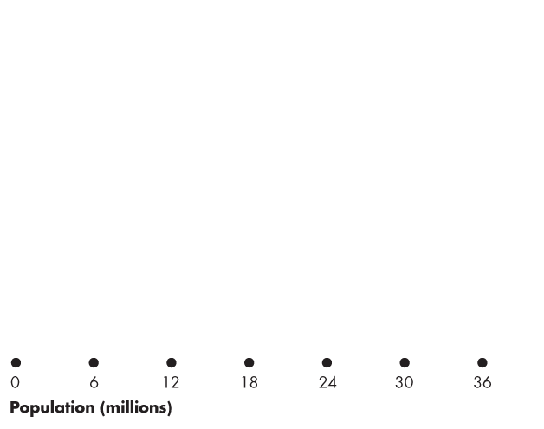
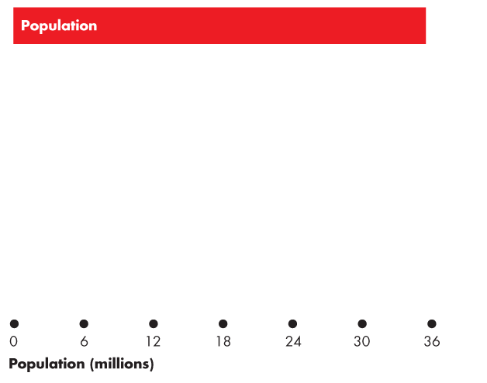
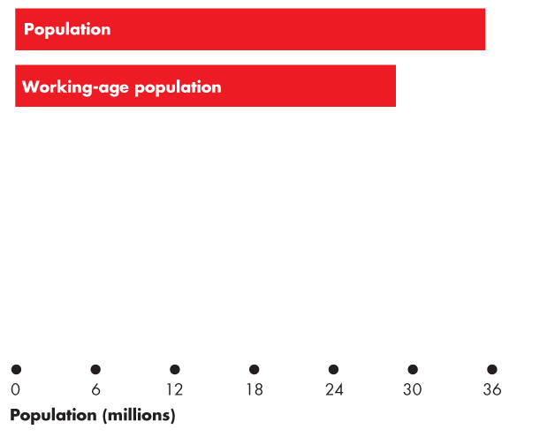
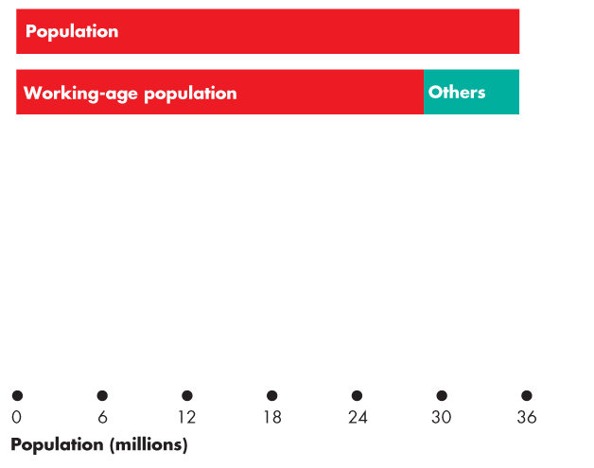
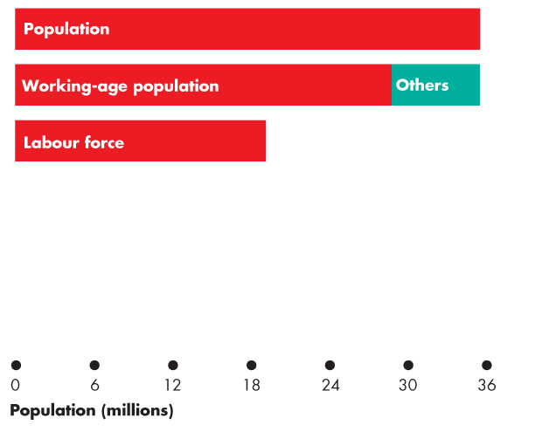
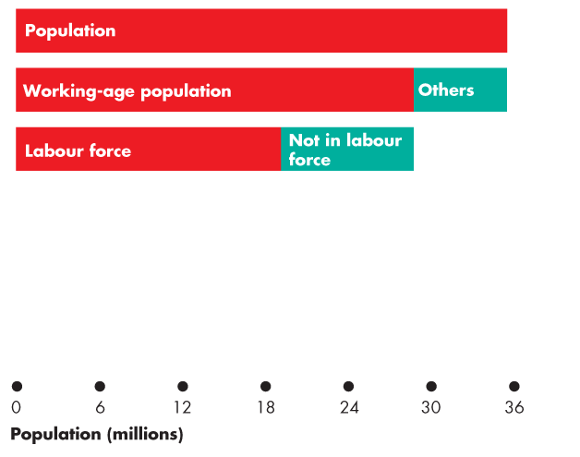
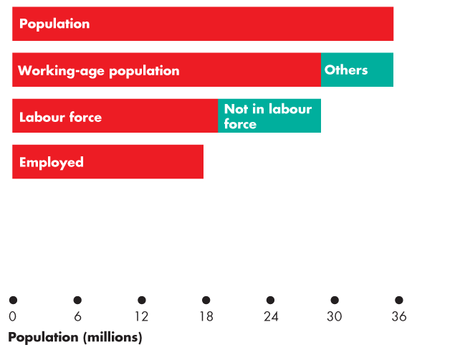
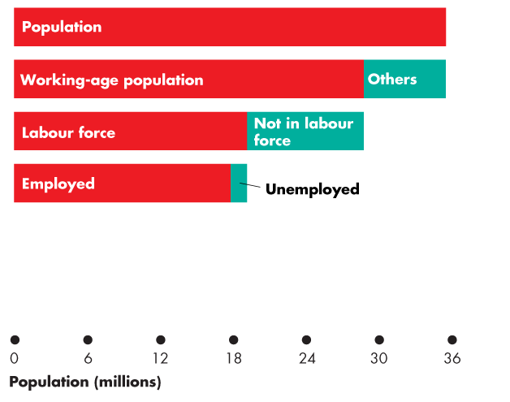
Employment and Unemployment
  Figure 21.1 shows the labour force categories.
  In 2013:
  Population: 35.4 million
  Working-age population: 28.7 million
  Labour force: 19.1 million
  Employment: 17.7 million
  Unemployment: 1.4 million
Notes:
Now ask: does all this unemployment bring benefits? The students quickly see that it would be very costly to organize rental markets in which cars don’t sit idle all day, and so on.
Now ask: do the same ideas apply to unemployed people? (Be sure to be compassionate about the misery that unemployment can bring. You are not claiming that it is not costly. You’re trying to identify the benefits, if any.)
You’ll quickly get your students to see that imagining an economy without any unemployment is nearly impossible. If consumers are free to change their decisions about what they want to buy, some goods and services must fall out of favor when others come into favor. The firms making the unfavoured products fall on hard times and often their workers are fired or laid off.
Sure, these laid off workers could start work right away, cleaning shoes or selling flowers at intersections. But they are better off (in their own opinion) being frictionally unemployed and searching for new jobs. To eliminate this source of unemployment we would need to forbid consumers from changing their buying plans or insist that no one remain idle and get on with doing any job even if it doesn’t earn a wage.
Note that if this is how we ran our economy, we’d still be using coal-fired stoves and the pony express, and we’d be wearing coonskin caps. There would be no McDonald’s, Federal Express, or Nike shoes.

Slide 10
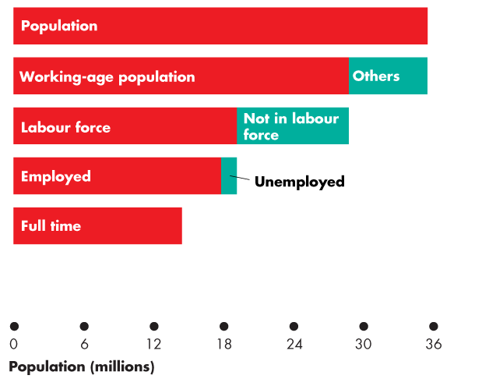
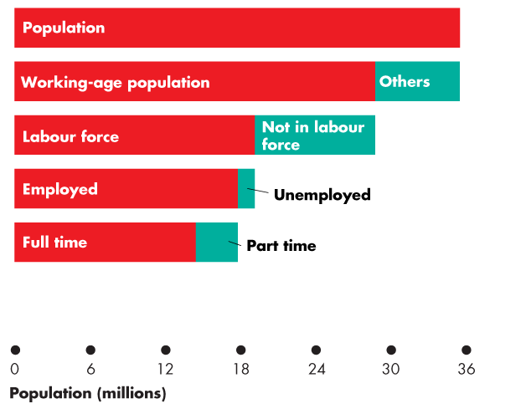
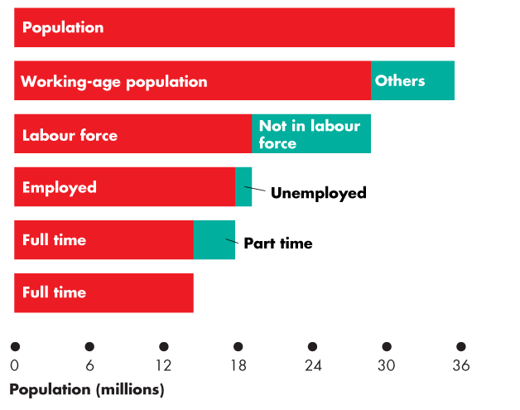
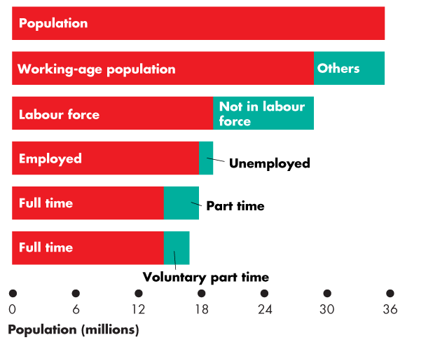
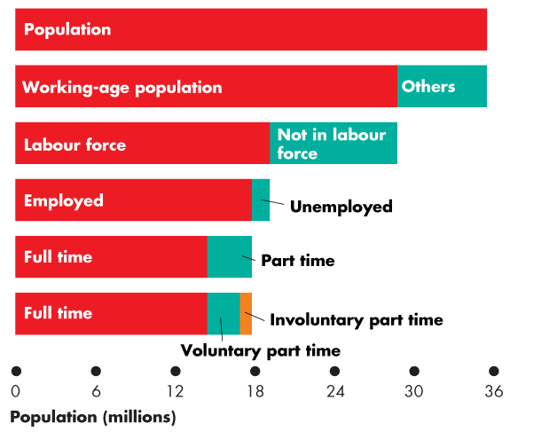

Slide 11
Employment and Unemployment
  Full-time employment: 14.3 million
  Part time: 3.4 million
  Voluntary part time: 2.5 million
  Involuntary part time: 0.9 million

Slide 12
Employment and Unemployment
Four Labour Market Indicators
  The unemployment rate
  Involuntary part-time rate
  The labour force participation rate
  The employment-to-population ratio

Slide 13
Employment and Unemployment
The Unemployment Rate
  The unemployment rate is the percentage of the labour force that is unemployed.
  The unemployment rate is
  (Number of people unemployed ÷ labour force) × 100.
  In 2013, the labour force was 19.08 million and
  1.35 million were unemployed, so the unemployment rate was 7.1 percent.
  The unemployment rate increases in a recession and reaches its peak value after the recession ends.

Slide 14
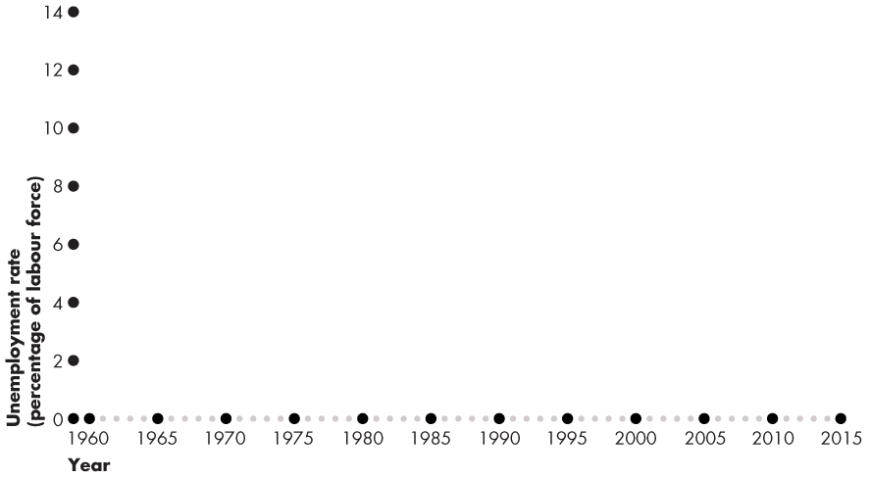
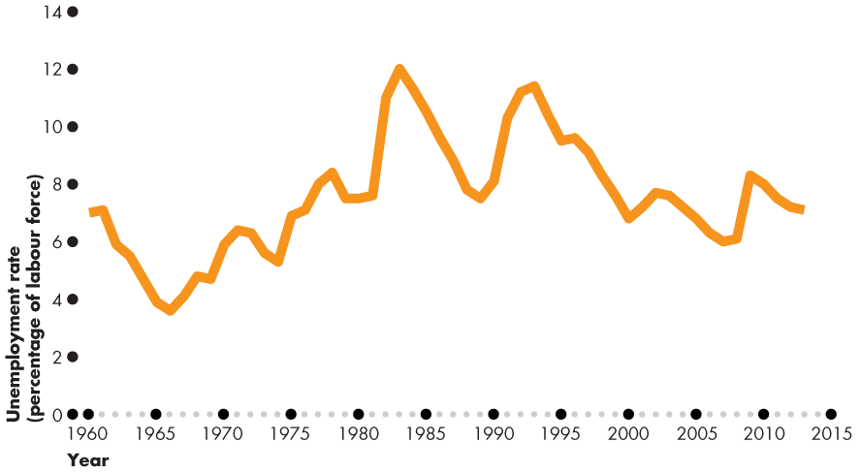
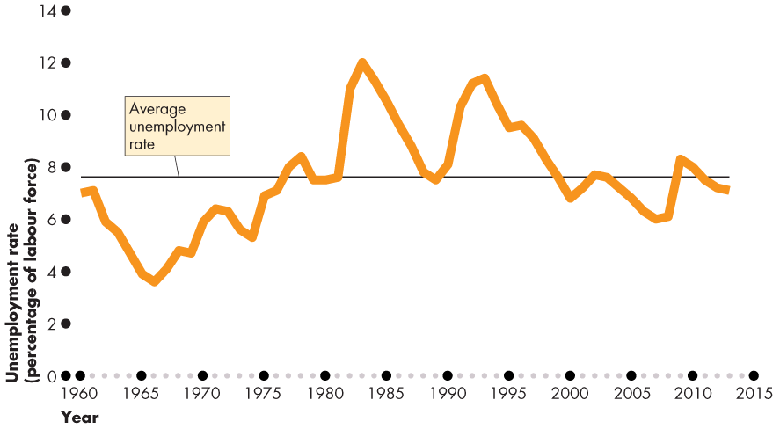
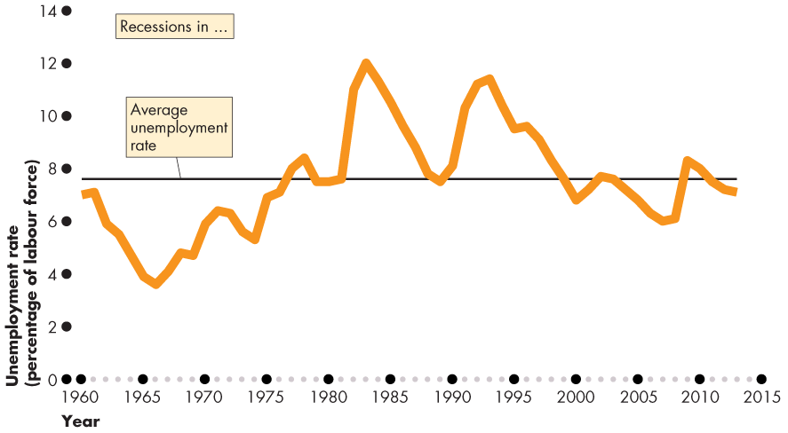
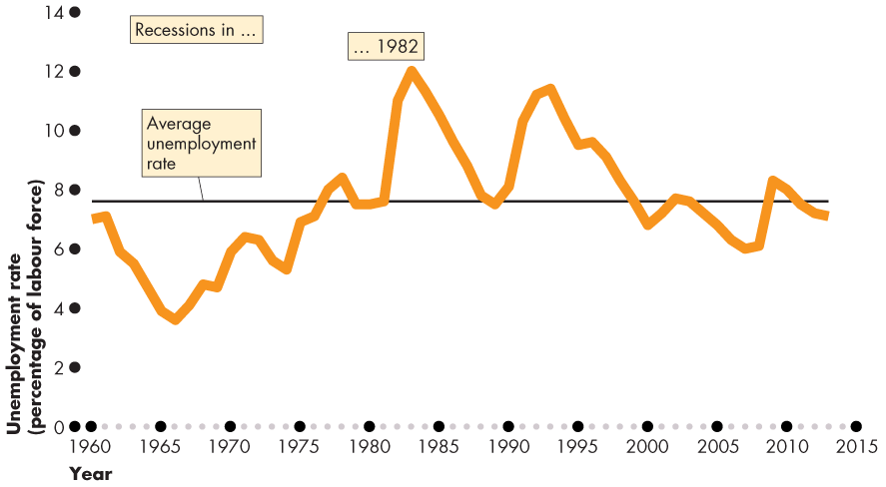
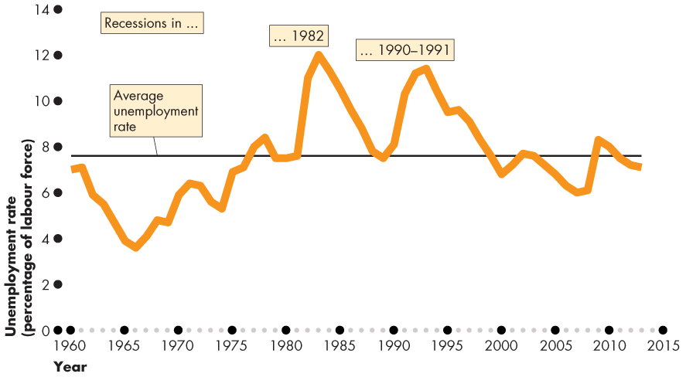
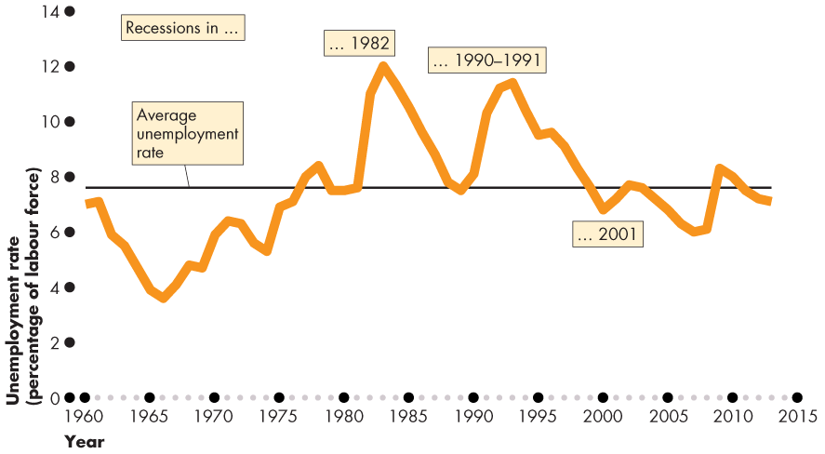
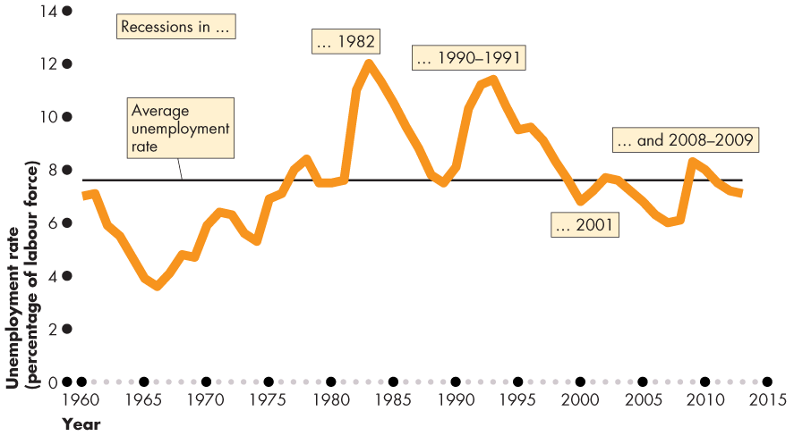
Employment and Unemployment
  Figure 21.2 shows the unemployment rate: 1960–2014.
  The unemployment rate increases in a recession.

Slide 16
Employment and Unemployment
The Involuntary Part-Time Rate
  The involuntary part-time rate is the percentage of the labour force who work part time but want full-time jobs.
  The involuntary part-time rate is
  (Number of involuntary part-time workers ÷ Labour force) × 100.
  In 2013, the 913,600 involuntary part-time workers and the labour force was 19.08 million.
  The involuntary part-time rate 4.8 percent.

Slide 17
Employment and Unemployment
The Labour Force Participation Rate
  The labour force participation rate is the percentage of the working-age population who are members of the labour force.
  The labour force participation rate is
  (Labour force ÷ Working-age population) × 100.
  In 2013, the labour force was 19.08 million and the working-age population was 28.67 million.
  The labour force participation rate was 66.5 percent.

Slide 18
Employment and Unemployment
The Employment-to-Population Ratio
  The employment-to-population ratio is the percentage of the working-age population who have jobs.
  The employment-to-population ratio is
  (Employment ÷ Working-age population) × 100.
  In 2013, the employment was 17.73 million and the working-age population was 28.67 million.
  The employment-to-population ratio was 61.8 percent.

Slide 19
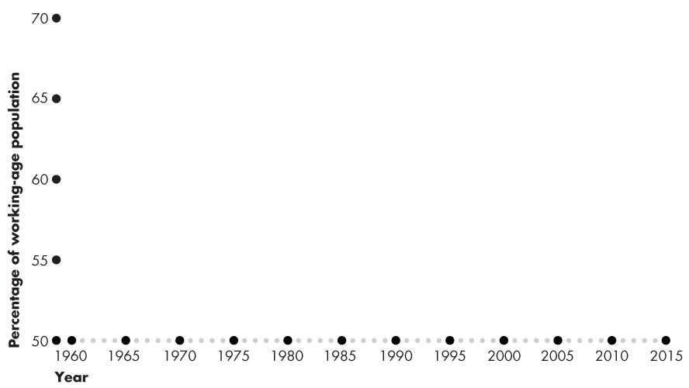
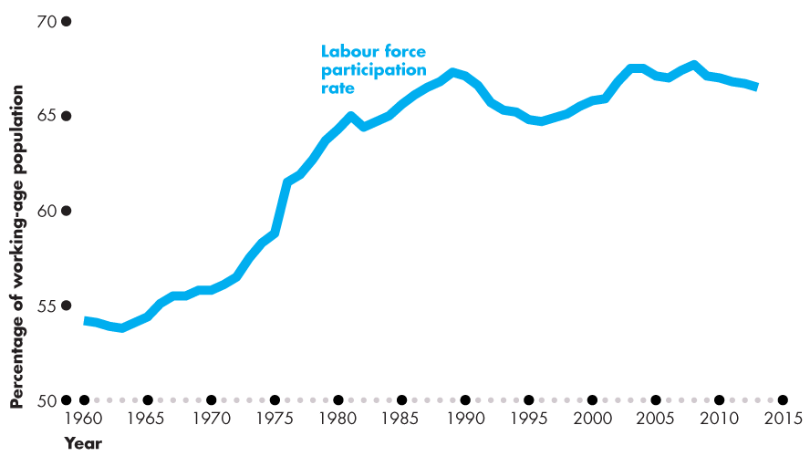
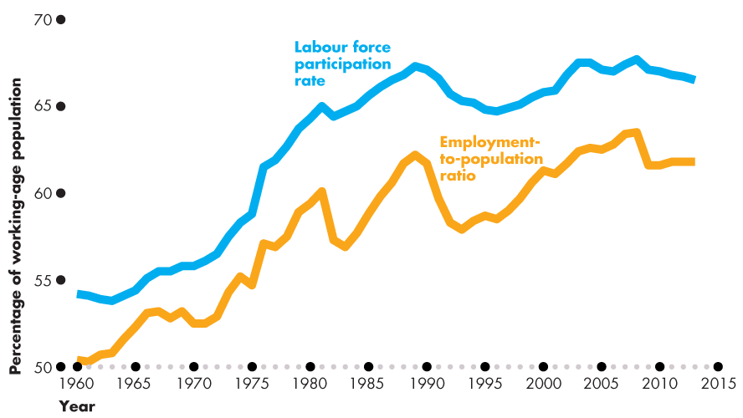
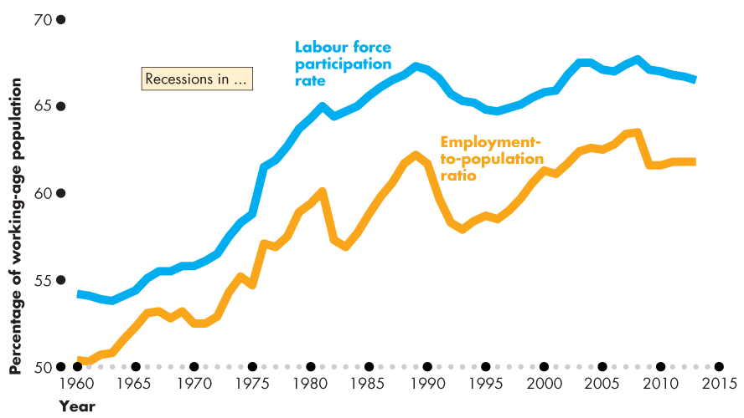
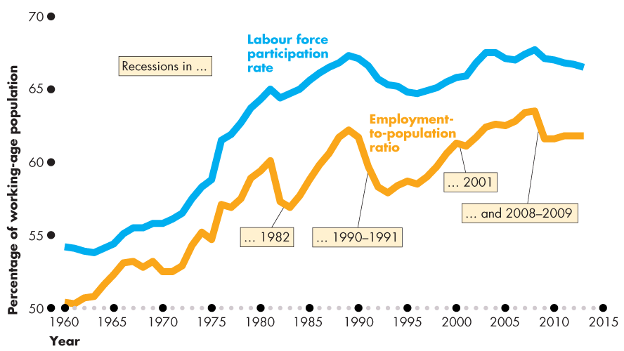
Employment and Unemployment
Figure 21.3 shows the labour force participation rate and employment-to-population ratio both trend upward rapidly before 1990 and slowly after 1990.

Slide 21
Employment and Unemployment
  Other Definitions of Unemployment
  The purpose of the unemployment rate is to measure the underutilization of labour resources.
  Statistics Canada believes that the unemployment rate gives a correct measure.
  But the official measure is an imperfect measure because it excludes
  Discouraged searchers
  Long-term future starts
  Involuntary part-timers

Slide 22
Employment and Unemployment
  Discouraged Searchers
  A discouraged searcher is a person who currently is neither working nor looking for work but has indicated that he or she wants and is available for a job and has looked for work sometime in the recent past but has stopped looking because of repeated failure.
  Long-Term Future Starts
  A person with a job to start in more than four weeks is not counted as unemployed.

Slide 23
Employment and Unemployment
  Part-Time Workers Who Want Full-Time Jobs
  Part-time workers who want full-time jobs and can’t find them are not counted as unemployed.
  Most Costly Unemployment
  All unemployment is costly, but the most costly is long-term unemployment that results from job loss.

Slide 24
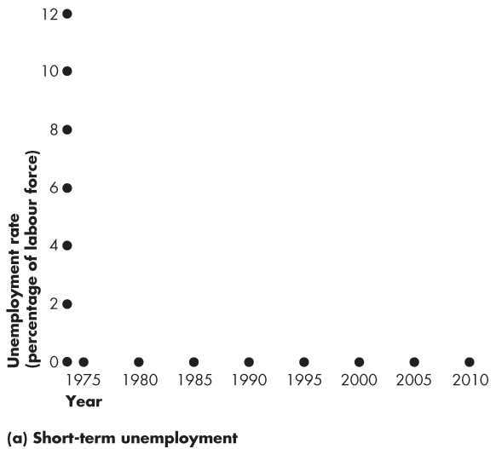
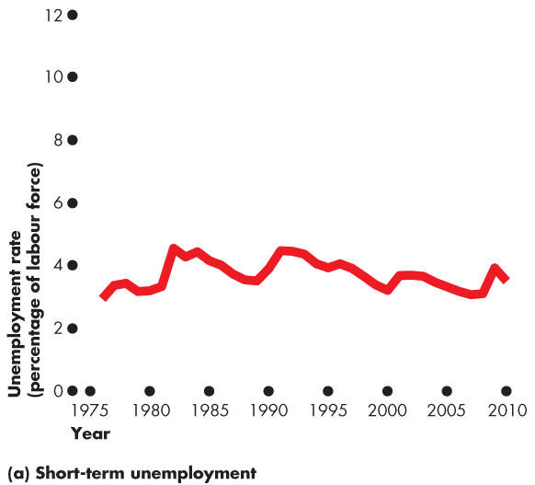
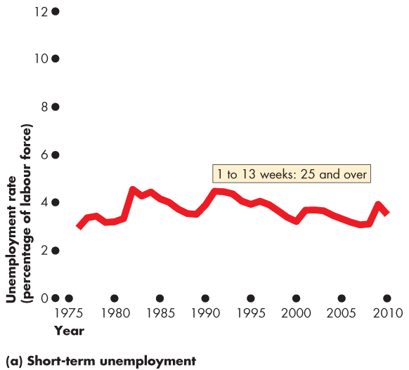
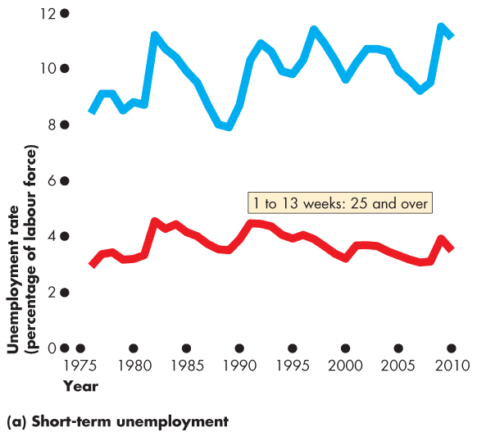
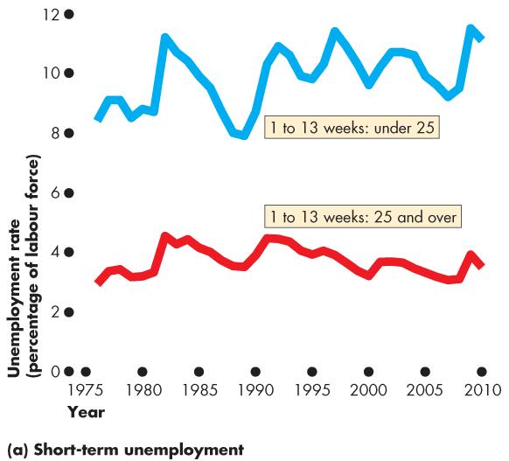
Unemployment and Full Employment
Figure 21.4(a) shows short-term unemployment.
For those over 25, short-term unemployment is around 4 percent and fluctuates only slightly over the business cycle.
For those under 25, short-term unemployment is high and fluctuates more strongly with the business cycle.

Slide 26
Employment and Unemployment
  Alternative Measures of Unemployment
Statistics Canada reports eight alternative measures of the unemployment rate: three narrower than the official measure and four broader ones.
The narrower measures, R-1 and R-2, focus on the personal cost of unemployment.
R-4 is the official unemployment rate; R-3 is comparable to the U.S. rate.
The broader measures, R-4, R-5, and R-6, focus on assessing the full amount of underemployed labour resources.
Notes:
Classroom activity
Check out Economics in the News: Jobs Growth in Recovery

Slide 27

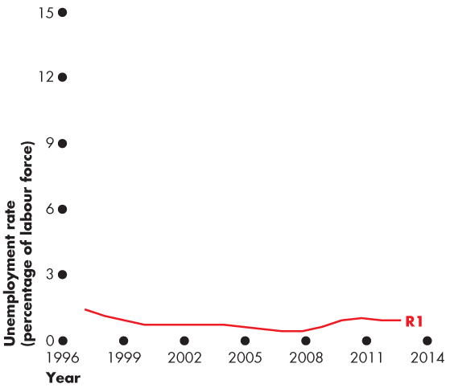
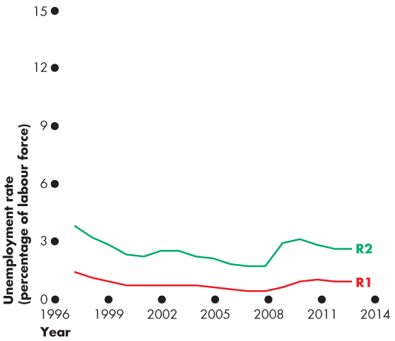
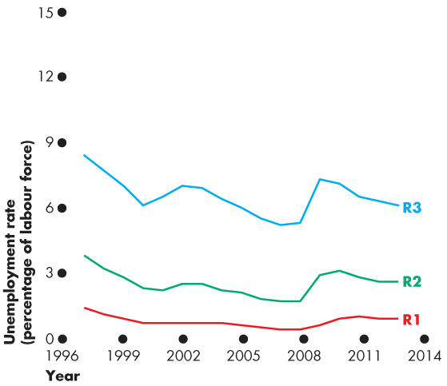
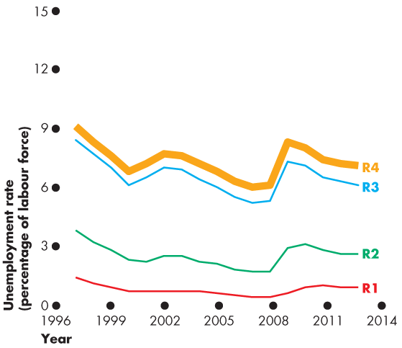
Employment and Unemployment
  Figure 22.4 shows eight alternative measures.
  R-1: Long-term unemployed (15 or more weeks)
  R-2: Short-term unemployed
  R-3: The unemployment rate comparable to the U.S. rate
  R-4: The official unemployment rate

Slide 28
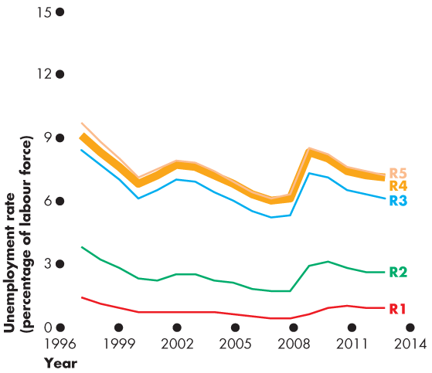
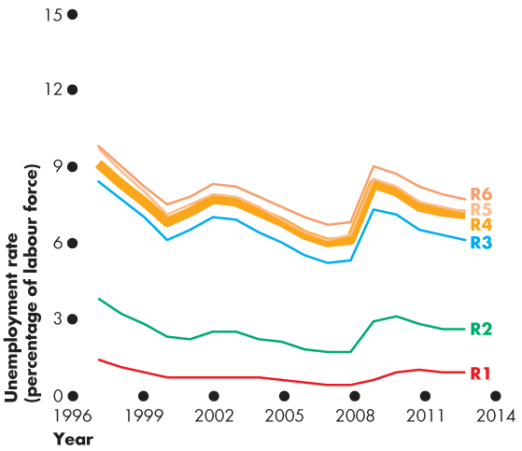
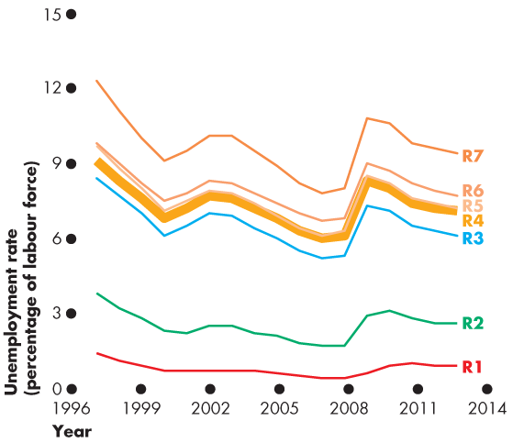
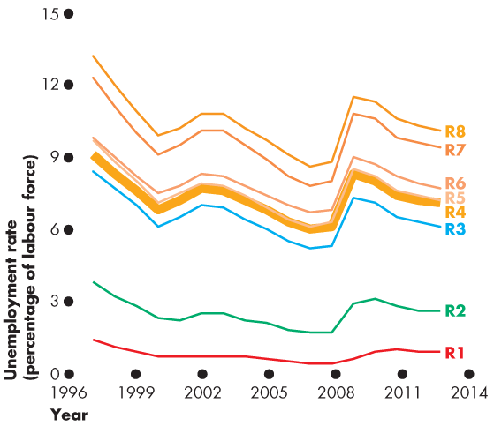
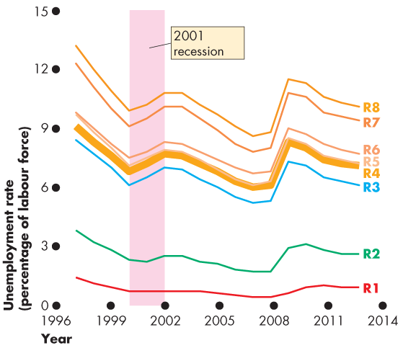
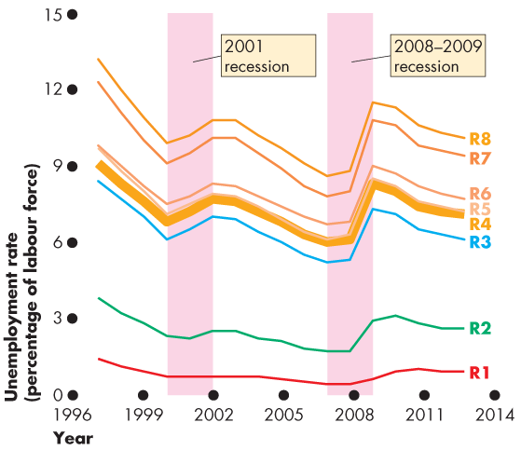

Slide 29
Employment and Unemployment
  Broader measures are
  U-5: U-4 + Discouraged searchers
  U-6: U-5 + Long-term future starts
  U-7: U-6 + involuntary part timers
  U-8: total underemployment
  All measures increase together in recession.

Slide 30
Unemployment and Full Employment
  Unemployment can be classified into three types:
  Frictional unemployment
  Structural unemployment
  Cyclical unemployment
Notes:
Identifying frictional, structural, and cyclical unemployment. Ask your class if anyone they know has been laid off. Then discuss whether losing a job creates frictional, structural, or cyclical unemployment. Look at your local examples. If you live in a steel-producing area, for example, you can talk about local structural unemployment arising from the closing of a steel manufacturer due to international competition. For cyclical unemployment, ask students how they think the business cycle and cyclical unemployment is related to full-time enrollments at higher education institutions. Students often don’t think there is any relationship. But nationally during a recession, the growth rate of full-time enrollments increases. Ask students if they can explain this relationship. The answer is that during a recession and due to the increase in cyclical unemployment, the opportunity cost of school decreases. This is a great way to keep students thinking about marginal benefits and costs.

Slide 31
Unemployment and Full Employment
  Frictional Unemployment
  Frictional unemployment is unemployment that arises from normal labour market turnover.
  The creation and destruction of jobs requires that unemployed workers search for new jobs.
  Increases in the number of people entering and reentering the labour force and increases in unemployment benefits raise frictional unemployment.
  Frictional unemployment is a permanent and healthy phenomenon of a growing economy.

Slide 32
Unemployment and Full Employment
  Structural Unemployment
  Structural unemployment is unemployment created by changes in technology and foreign competition that change the skills needed to perform jobs or the locations of jobs.
  Structural unemployment lasts longer than frictional unemployment.
Notes:
Classroom activity
Check out Economics in Action: Structural Unemployment in Canada

Slide 33
Unemployment and Full Employment
  Cyclical Unemployment
  Cyclical unemployment is the higher than normal unemployment at a business cycle trough and lower than normal unemployment at a business cycle peak.
  A worker laid off because the economy is in a recession and is then rehired when the expansion begins experiences cycle unemployment.

Slide 34
Unemployment and Full Employment
“Natural” Unemployment
Natural unemployment is the unemployment that arises from frictions and structural change when there is no cyclical unemployment.
Natural unemployment is all frictional and structural unemployment.
  The natural unemployment rate is natural unemployment as a percentage of labour force.

Slide 35
Unemployment and Full Employment
  Full employment is defined as the situation in which the unemployment rate equals the natural unemployment rate.
  When the economy is at full employment, there is no cyclical unemployment or, equivalently, all unemployment is frictional and structural.

Slide 36
Unemployment and Full Employment
  The natural unemployment rate changes over time and is influenced by many factors.
Key factors are
The age distribution of the population
The scale of structural change
The real wage rate
Unemployment benefits

Slide 37
Unemployment and Full Employment
Real GDP and Unemployment Over the Cycle
  Potential GDP is the quantity of real GDP produced at full employment.
  Potential GDP corresponds to the capacity of the economy to produce output on a sustained basis.
  Real GDP minus potential GDP is the output gap.
  Over the business cycle, the output gap fluctuates and the unemployment rate fluctuates around the natural unemployment rate.

Slide 38
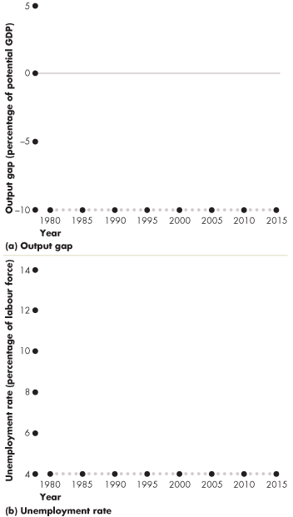
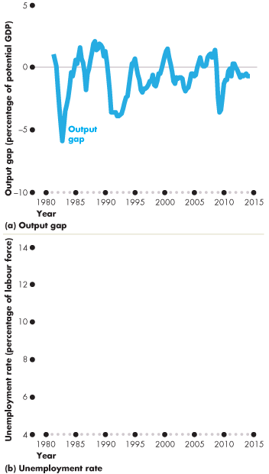
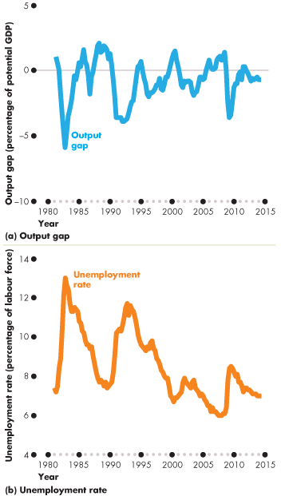
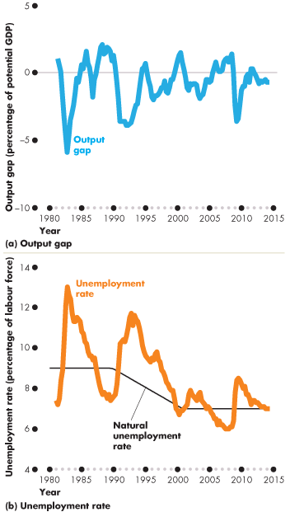
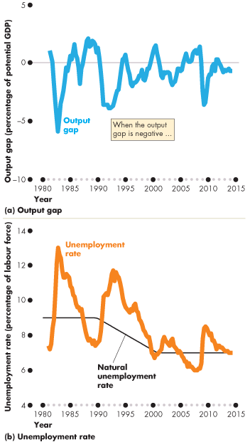
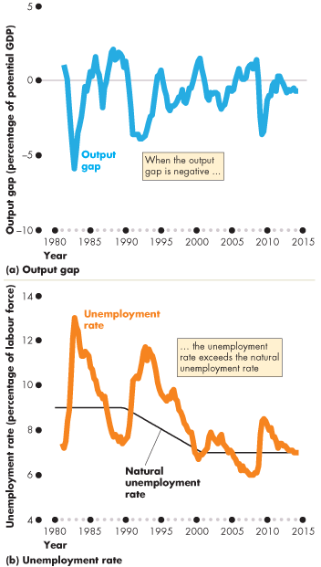
Unemployment and Full Employment
  Figure 21.5 shows the output gap and …
  the fluctuations of unemployment around the natural rate.
  When the output gap is negative, unemployment exceeds the natural unemployment rate.

Slide 40
Price Level, Inflation, and Deflation
  The price level is the average level of prices and the value of money.
  A persistently rising price level is called inflation.
  A persistently falling price level is called deflation.
  We are interested in the price level because we want to
  1. Measure the inflation rate or the deflation rate
  2. Distinguish between money values and real values of economic variables.

Slide 41
Price Level, Inflation, and Deflation
  Why Inflation and Deflation Are Problems
  Low, steady, and anticipated inflation or deflation is not a problem.
  Unpredictable inflation or deflation is a problem because it
  Redistributes income and wealth
  Lowers real GDP and employment
  Diverts resources from production

Slide 42
Price Level, Inflation, and Deflation
  Unpredictable changes in the inflation rate redistribute income in arbitrary ways between employers and workers and between borrowers and lenders.
  A high inflation rate is a problem because it diverts resources from productive activities to inflation forecasting.
  From a social perspective, this waste of resources is a cost of inflation.
  At its worse, inflation becomes hyperinflation—an inflation rate that is so rapid that workers are paid twice a day because money loses its value so quickly.

Slide 43
Price Level, Inflation, and Deflation
  The Consumer Price Index
  The Consumer Price Index, or CPI, measures the average of the prices paid by urban consumers for a “fixed” basket of consumer goods and services.
Notes:
The CPI—an average. It is important for students to understand that the CPI is based on the average expenditure basket, not the expenditure pattern of any given household. Displaying the detailed press releases on the BLS Web site helps make this point very forcibly: students often do not realize until they see the numbers that the CPI must include both costs of owning a house and costs of renting one; costs of buying a car and costs of public transportation; and so on.

Slide 44
Price Level, Inflation, and Deflation
Reading the CPI Numbers
  The CPI is defined to equal 100 for the reference base period.
  Currently, the reference base period is 2002.
  That is, for the average CPI of the 12 months of 2002 equals 100.
  In June 2014, the CPI was 125.6.
  This number tells us that the average of the prices paid by urban consumers for a fixed basket of goods was 25.6 percent higher in June 2014 than it was during 2002.

Slide 45
Price Level, Inflation, and Deflation
Constructing the CPI
  Constructing the CPI involves three stages:
  Selecting the CPI basket
  Conducting a monthly price survey
  Calculating the CPI

Slide 46
Price Level, Inflation, and Deflation
  The CPI Basket
  The CPI basket is based on a consumer expenditure survey conducted by Statistics Canada, which is undertaken infrequently.
  Today’s CPI basket today is based on data collected in the Consumer Expenditure Survey of 2011 and valued at prices in January 2013.

Slide 47
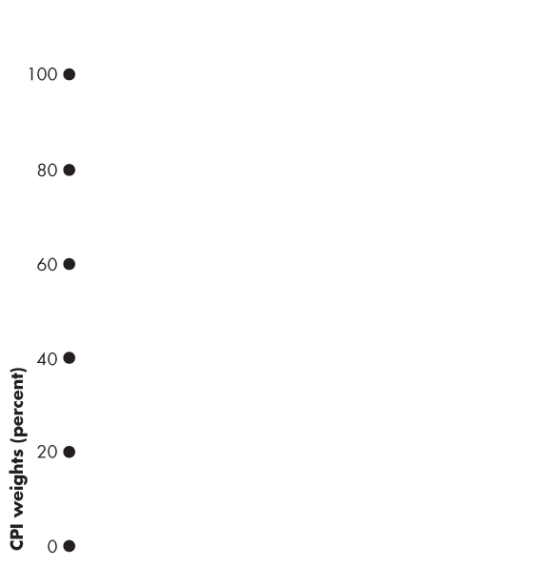
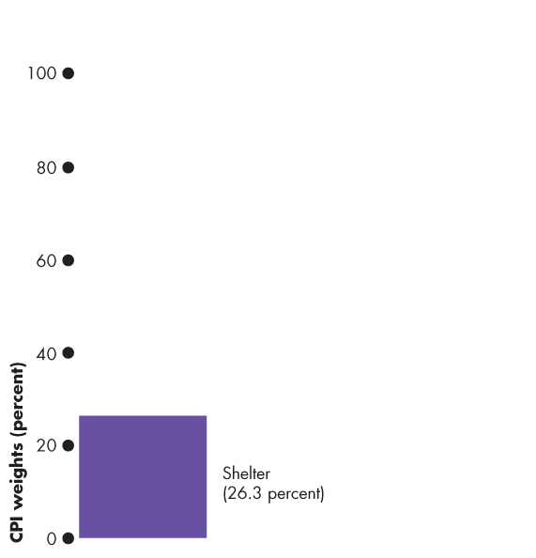
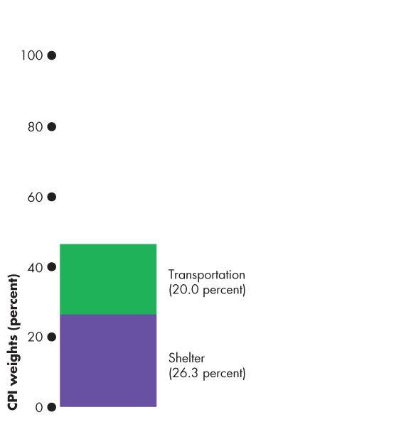





Price Level, Inflation, and Deflation
  Figure 21.6 illustrates the CPI basket.
  Shelter is the largest component.
  Transportation and food and beverages are the next largest components.
  The remaining components account for 37 percent of the basket.
Notes:
Making the CPI personal. If you have time (or want to make time) you can get your students to construct their own CPI basket. Each student makes a statement of her/his expenditure in the same categories as the CPI basket in the figure on this slide. Students then compare their expenditure patterns to the average of the CPI basket.

Slide 49
Price Level, Inflation, and Deflation
  The Monthly Price Survey
  Every month, Statistics Canada employees check the prices of the goods and services in the CPI basket in the major cities.
  Calculating the CPI
  1. Find the cost of the CPI basket at base-period prices.
  2. Find the cost of the CPI basket at current-period prices.
  3. Calculate the CPI for the current period.

Slide 50




Price Level, Inflation, and Deflation
  Let’s work an example of the CPI calculation.
  In a simple economy, people consume only oranges and haircuts.
  The CPI basket is 10 oranges and 5 haircuts.
  The table also shows the prices in the base period.
  The cost of the CPI basket in the base period was $50.

Slide 51


Slide 52



Price Level, Inflation, and Deflation
  Table 21.1(b) shows the fixed CPI basket of goods.
  It also shows the prices in the current period.
  The cost of the CPI basket at current-period prices is $70.

Slide 53
Price Level, Inflation, and Deflation
  The CPI is calculated using the formula:
  CPI = (Cost of basket at current-period prices ÷ Cost of basket at base-period prices)  100.
  Using the numbers for the simple example,
  CPI = ($70 ÷ $50)  100 = 140.
  The CPI is 40 percent higher in the current period than it was in the base period.

Slide 54
Price Level, Inflation, and Deflation
Measuring the Inflation Rate
  The major purpose of the CPI is to measure inflation.
  The inflation rate is the percentage change in the price level from one year to the next.
  The inflation formula is:
  Inflation rate = [(CPI this year – CPI last year) ÷ CPI last year] × 100.

Slide 55



Price Level, Inflation, and Deflation
  Figure 21.7 shows the relationship between the price level and the inflation rate.
  Figure 21.7(a) shows the CPI from 1970 to 2014.

Slide 56








Slide 57
Price Level, Inflation, and Deflation
  Figure 21.7(b) shows that the inflation rate is:
  High when the price level is rising rapidly

Slide 58
Price Level, Inflation, and Deflation
  Low when the price level is rising slowly
  Negative when the price level is falling

Slide 59
Price Level, Inflation, and Deflation
The Biased CPI
  The CPI might overstate the true inflation for four reasons:
  New goods bias
  Quality change bias
  Commodity substitution bias
  Outlet substitution bias
Notes:
CPI biases—concrete illustrations. New goods bias can be illustrated with MP3 music rather than CDs; quality change with computers and cars; commodity substitution with movies versus videos; and outlet substitution by the growth of Wal-mart, Target, and shopping on the internet.

Slide 60
Price Level, Inflation, and Deflation
  New Goods Bias
  New goods that were not available in the base year appear and, if they are more expensive than the goods they replace, they put an upward bias into the CPI.
  Quality Change Bias
  Quality improvements occur every year. Part of the rise in the price is payment for improved quality and is not inflation.
  The CPI counts all the price rise as inflation.

Slide 61
Price Level, Inflation, and Deflation
  Commodity Substitution Bias
  The market basket of goods used in calculating the CPI is fixed and does not take into account consumers’ substitutions away from goods whose relative prices increase.
  Outlet Substitution Bias
  As the structure of retailing changes, people switch to buying from cheaper sources, but the CPI, as measured, does not take account of this outlet substitution.

Slide 62
Price Level, Inflation, and Deflation
The Magnitude of the Bias
Estimates say that the CPI overstates inflation by
0.6 percentage points a year.
Some Consequences of the Bias
  Distorts private contracts.
  Increases government outlays (close to a third of federal government outlays are linked to the CPI).
  A bias of 0.6 percent is small, but over a decade adds up to billions of dollars of additional expenditure.

Slide 63
Price Level, Inflation, and Deflation
Alternative Price Indexes
  Alternative measures of the price level are
  GDP deflator
  Chained price index for consumption

Slide 64
Price Level, Inflation, and Deflation
GDP Deflator
The GDP deflator equals
(Nominal GDP ÷ Real GDP)  100
GDP deflator is a broader measure of the price level than the CPI because it includes all consumption expenditure, investment, government expenditure on goods and services, and net exports.
But as a cost of living, the GDP deflator is too broad.
Over the period 2000 to 2014, the GDP deflator increased by an average rate of 2.2 percent a year, which is 0.3 percentage points above the CPI inflation rate.

Slide 65
Price Level, Inflation, and Deflation
CPIC is an index of the prices of all the items included in consumption expenditure in GDP.
CPIC = (Nominal consumption expenditure ÷ Real consumption expenditure)  100
Because both GDP deflator and CPIC use current-period and previous-period quantities rather than fixed quantities from an earlier period, they incorporates substitution effects and new goods and overcomes the sources of bias in the CPI.
Over the period 2000 to 2014, CPIC increased by an average rate of 1.5 percent a year, which is 0.4 percentage points below the CPI inflation rate.

Slide 66



Price Level, Inflation, and Deflation
Core Inflation Rate
The core inflation rate is an inflation rate excluding the volatile elements (of food and fuel).
The core inflation rate attempts to reveal the underlying inflation trend.
The most common measure of core inflation is the core CPI inflation rate.

Slide 68
Price Level, Inflation, and Deflation
The Real Variables in Macroeconomics
  We can use the GPD deflator to deflate nominal variables to find their real values.
  For example,
  Real wage rate = (Nominal wage rate ÷ GDP deflator)  100
  But not the real interest rate! It is different.

